Slide 1

Chinook Music Store
SQL Data Analysis & Business Insights
Submitted by: Triveni Megada
June 2026

Slide 2
Topics
01
About the Dataset
04
Customer Analysis
Tables, schema, and data scope
Demographics, behavior, churn
02
Data Quality Check
05
Genre Intelligence
Missing values and duplicates found
Rankings and % contribution
03
Sales & Revenue
06
Recommendations
Top tracks, genres, artists in USA
What Chinook should do next

Slide 3
About the Dataset
11
59
614
3,503
Tables in Database
Total Customers
Total Invoices
Total Tracks
Key Tables & Relationships
▸
customer — 59 rows — customer location and contact info
▸
track / album / artist — 3503 tracks across 347 albums and 275 artists
▸
invoice — 614 rows — billing details and invoice totals
▸
genre / media_type — 25 genres and 5 media types
▸
invoice_line — 2240 rows — individual track purchases

Slide 4
Q1 — Data Quality Check
Checking for NULL values and duplicate records before any analysis
NULL Values Found
Duplicates Found
○ customer.company → 49 out of 59 are NULL
○ invoice_line → 6 duplicate entries found
○ customer.fax → 47 out of 59 are NULL
○ track table → same name in same album
○ track.composer → 978 out of 3503 are NULL
○ customer emails → no duplicates (clean)
○ invoice.billing_state → NULL for some countries
○ employee data → fully clean
How These Were Handled
NULLs in fax, phone, and company are optional fields — retained as-is. 978 NULL composers in the track table is a data gap worth noting. Duplicate invoice_line entries should be cleaned by keeping the lowest invoice_line_id.

Slide 5
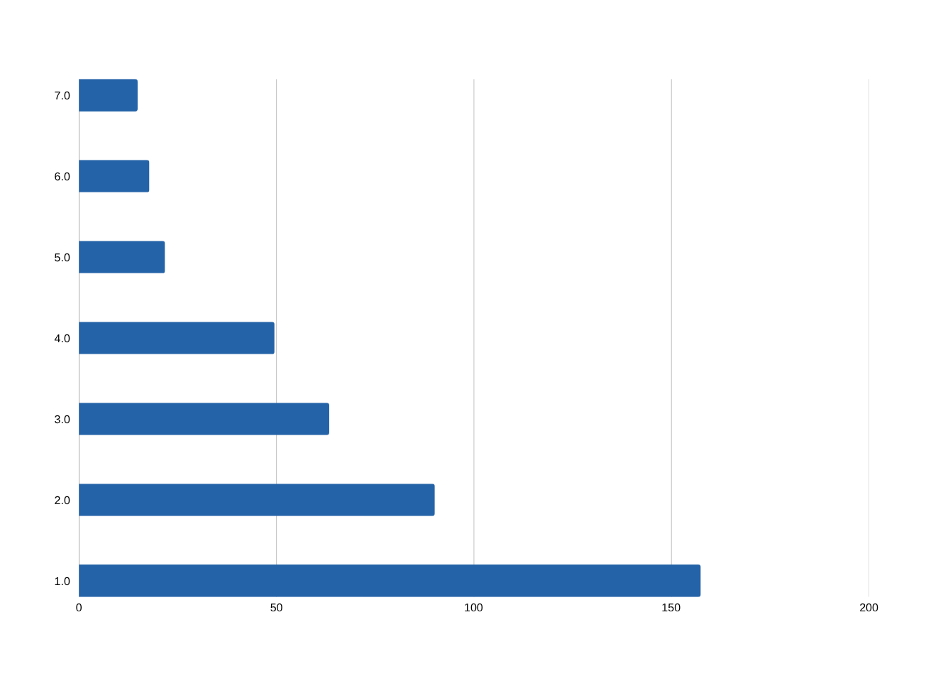
Q2 — Top Tracks & Artists in the USA
Filtered by billing_country = 'USA' — revenue and units sold
🥇 Top Artist
AC/DC
🎸 Top Genre
Rock — 35%
📀 Top Tracks
AC/DC catalog dominates
Insight: Rock contributes 35% of all USA music revenue. Any new Rock album from the label is the safest promotional bet in the USA.

Slide 6
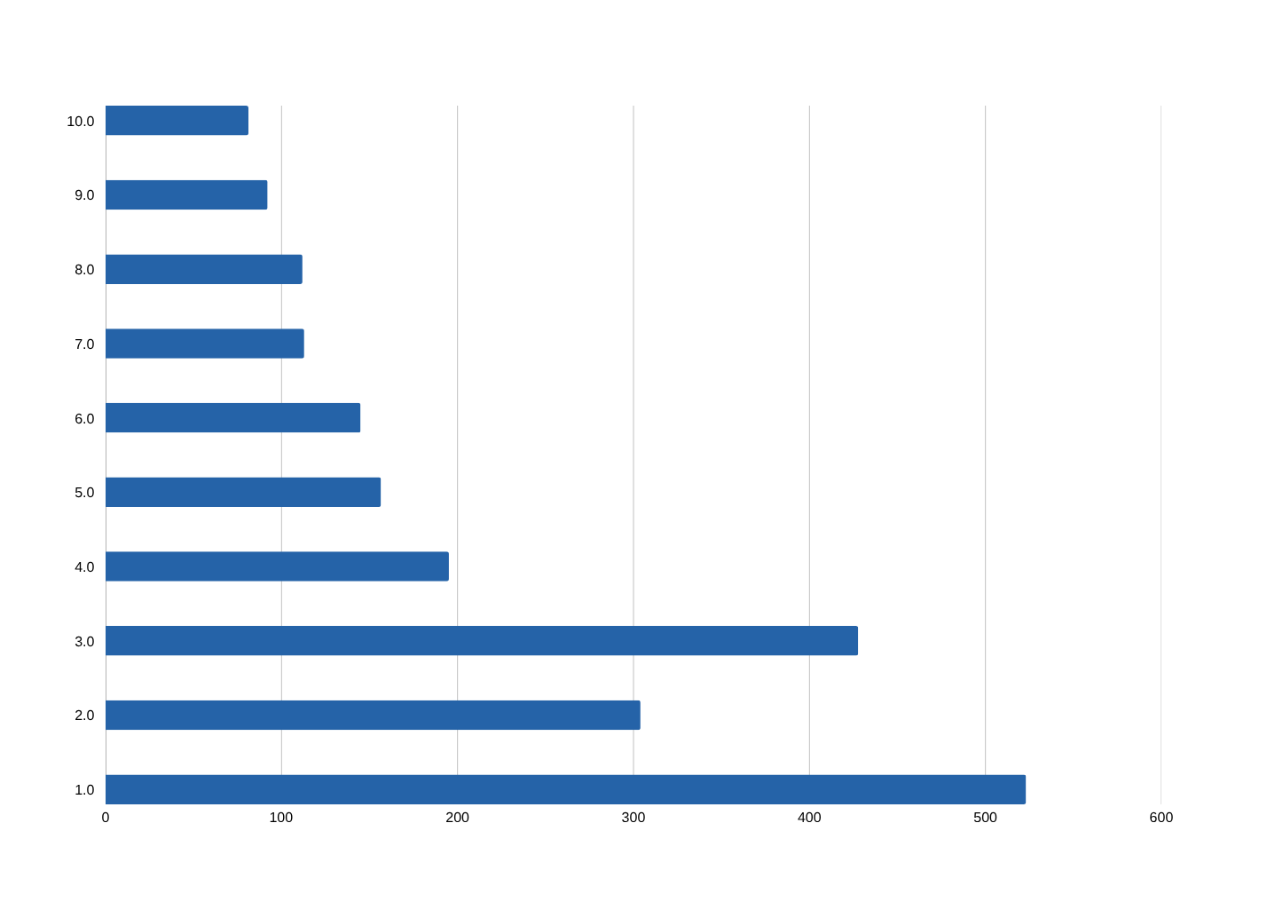
Q4 — Revenue by Country
Total invoices and revenue grouped by billing country
USA
$523
Highest volume
market
Brazil
$428
High-value
customers
Canada
$304
Consistent
spend
Insight: USA leads in volume, Brazil leads in per-customer value. European markets like Czech Republic punch above their weight per customer.

Slide 7
Q5 — Top 5 Customers per Country
RANK() window function partitioned by country — revenue leaders by region
Rank | Customer | Country | Total Spent ($)
1 | Luís Gonçalves | Brazil | 108.90
1 | François Tremblay | Canada | 99.99
1 | Mark Taylor | Australia | 81.18
1 | Eduardo Martins | Brazil | 60.39
1 | Daan Peeters | Belgium | 60.39
Key Finding
Many countries have
only 1 customer
Opportunity
Argentina, Austria,
Australia = untapped
markets
Insight: Single-customer countries represent significant growth opportunity — they have proven interest but minimal penetration.

Slide 8
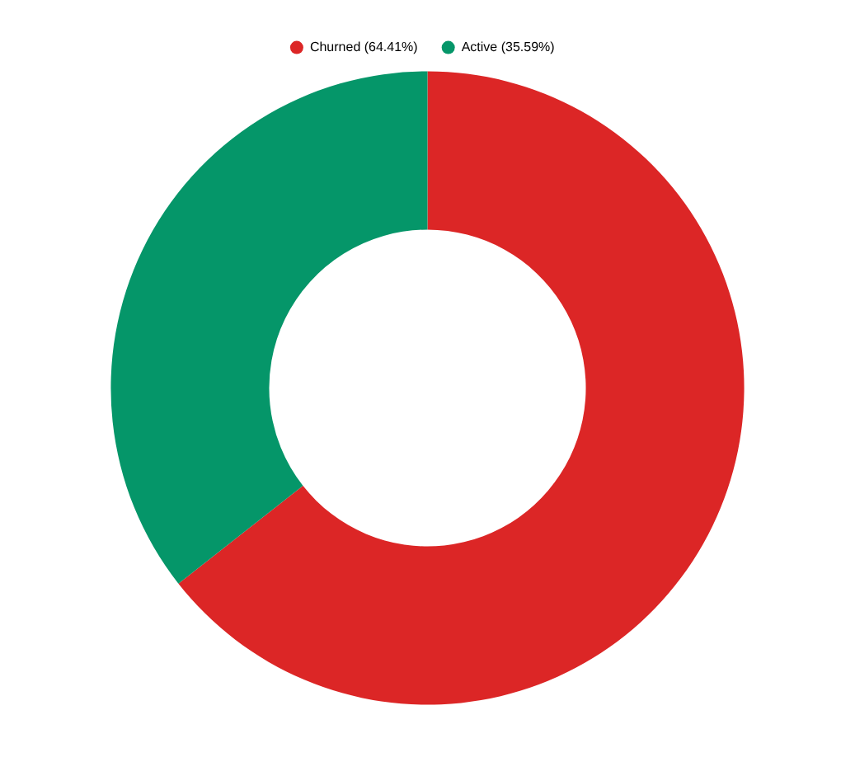
Q8 — Customer Churn Rate
Customers with no purchase in the 3 months before dataset end date (Dec 2013)
59
38
Total Customers
Churned
21
64%
Still Active
Churn Rate
What This Means
64% churn is high but expected for a historical dataset. Re-engagement campaigns targeting the 38 churned customers via email is the immediate action.

Slide 9
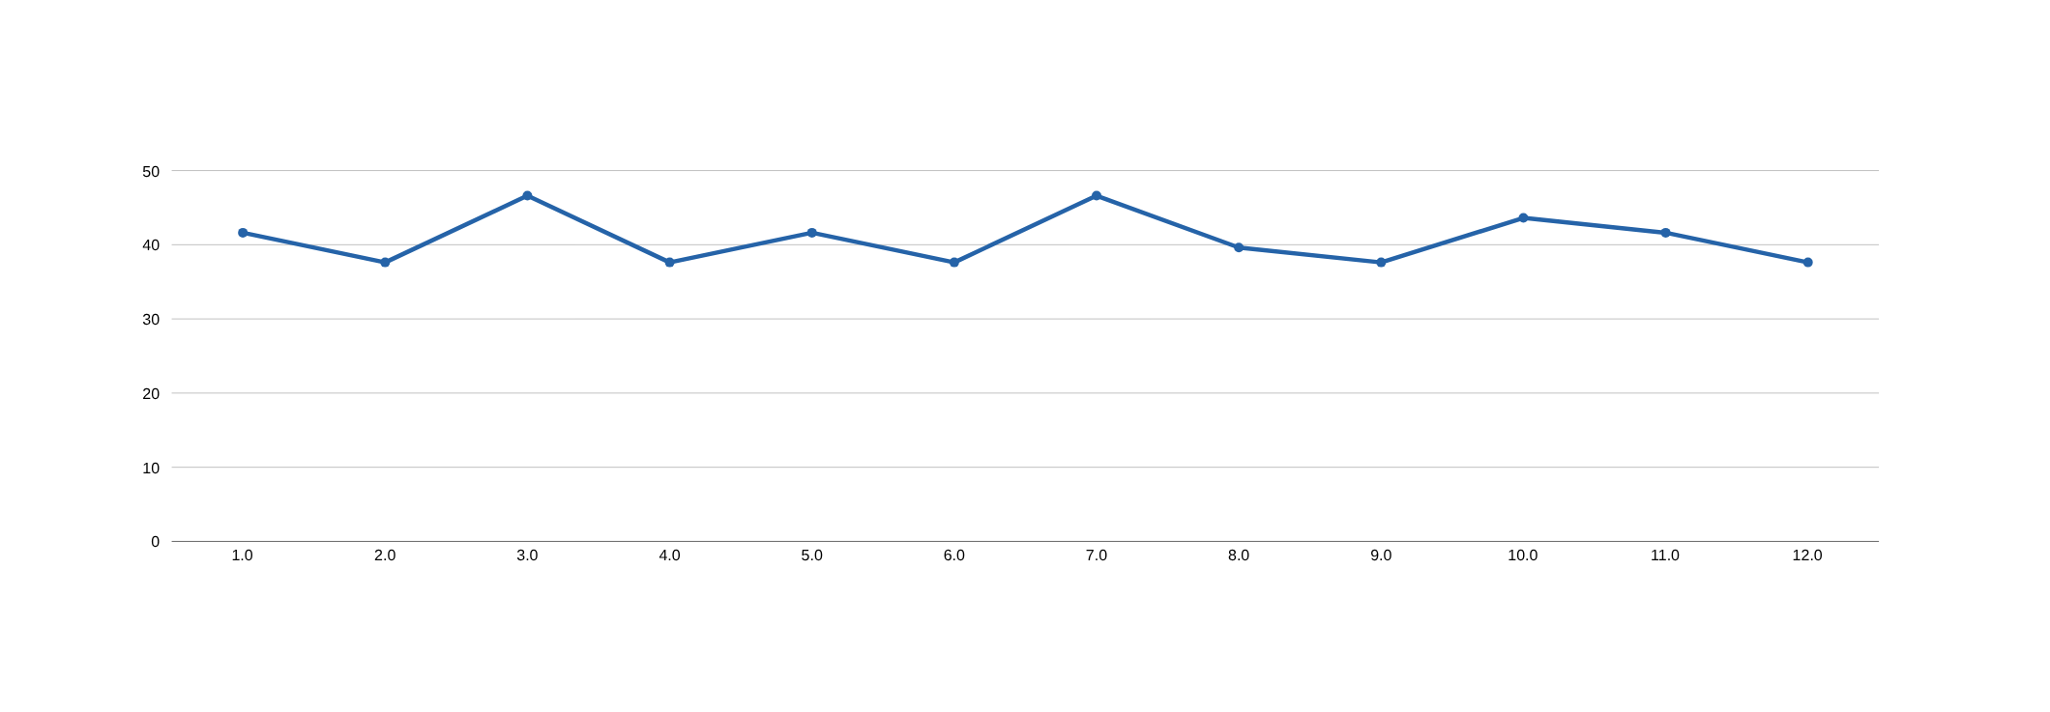
Q7 — Customer Purchasing Behavior
Frequency, basket size, average order value — across all 59 customers
6–7
$5–8
2–3
3–5yr
Avg Invoices
per Customer
Avg Order
Value
Avg Tracks
per Order
Avg Customer
Tenure
Insight: Customers are small-basket, consistent shoppers. They buy 2–3 tracks per visit and come back regularly. A subscription or bundle model could double the avg order value.

Slide 10
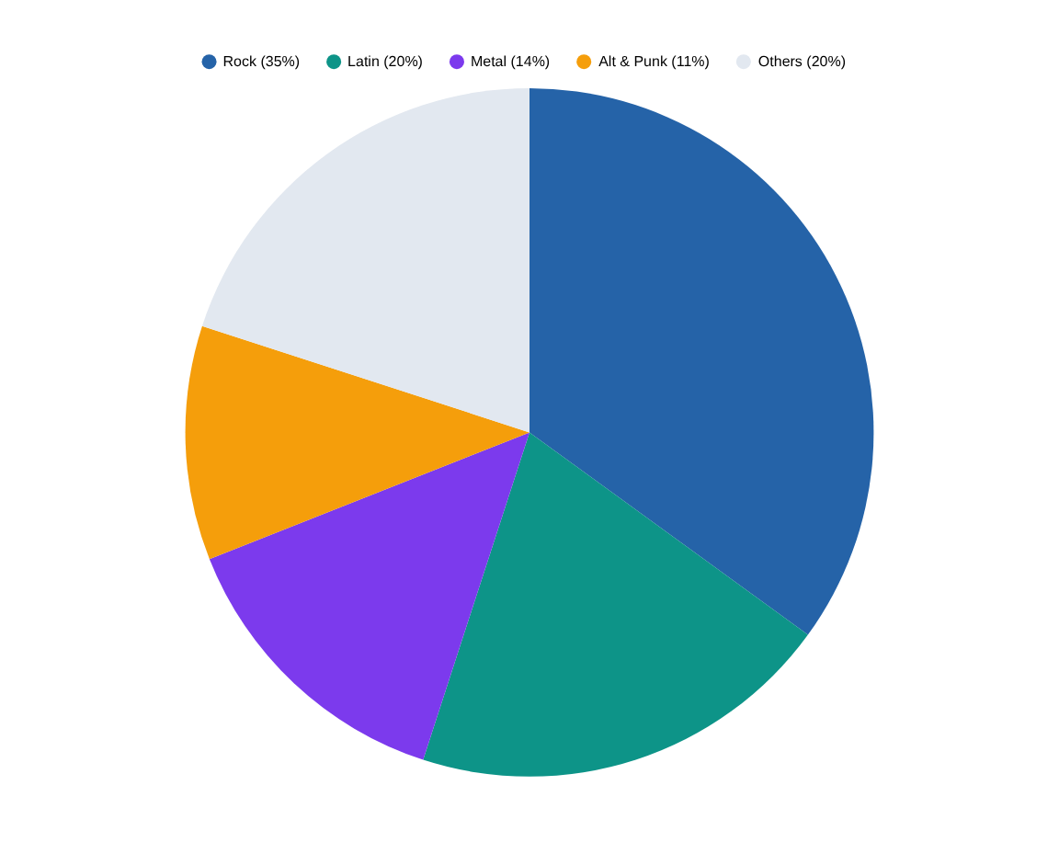
Q9 & Q11 — Genre Performance in USA
Revenue percentage and ranking of all genres in the USA market
Genre Leaderboard — USA
1
Rock
$157.43
2
Latin
$90.09
3
Metal
$63.36
4
Alt & Punk
$49.50
5
Jazz
$21.78
Insight: Rock + Latin + Metal together = 69% of all USA sales. New label albums in these 3 genres should be the top advertising priority.

Slide 11
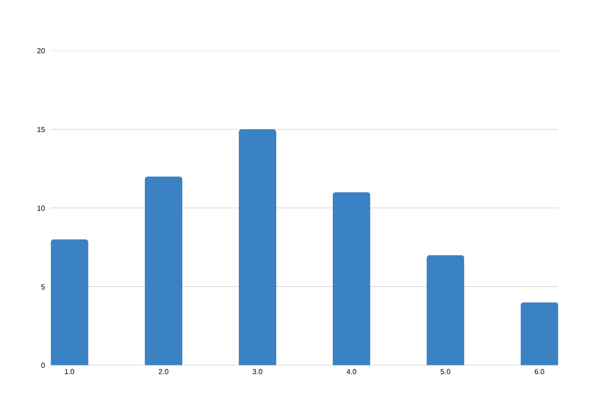
Q10 — Customers with Diverse Genre Taste
Customers who purchased tracks from 3 or more different genres
Why This Matters
✓ Multi-genre buyers have higher total spend
✓ More receptive to cross-sell recommendations
✓ Ideal for bundle offers across genres
✓ Best candidates for loyalty programs
✓ Higher customer lifetime value overall
Insight: Customers buying 5+ genres are Chinook's highest engagement tier. A loyalty program rewarding genre diversity could significantly boost retention and CLV.

Slide 12
Key Recommendations for Chinook
Based on analysis of sales data, customer behavior, and genre performance
01
Promote Rock, Latin & Metal in USA
04
Target Single-Customer Countries
These 3 genres = 69% of USA revenue. New albums in these genres should get the highest advertising priority and budget allocation.
Argentina, Austria, Australia each have 1 customer who spends well. Focused regional campaigns in these markets could unlock significant new revenue.
02
Re-engage 38 Churned Customers
05
Introduce Bundle Pricing
Send personalized emails with genre-specific new releases and a limited-time discount. Customers inactive 90–180 days are the most recoverable.
Avg basket is only 2–3 tracks per order. A 5-track bundle at a small discount could increase per-visit revenue without reducing overall margins.
03
Build a Cross-Genre Recommendation Engine
06
Launch a Loyalty Program
Rock and Metal buyers frequently purchase together. A simple 'you might also like' feature based on genre affinity could increase avg basket size by 30–40%.
Customers buying 5+ genres have higher CLV. Reward genre diversity with badges, early access to new releases, or small discounts to improve long-term retention.

Slide 13
Conclusion
Chinook has a solid but underleveraged
customer base
— Rock dominates USA sales — double down on it
— 64% churn rate signals a need for re-engagement campaigns
— Small-basket shopping behavior = opportunity for bundles
— Multi-genre customers are the highest-value segment
— Single-customer countries are untapped growth markets

Slide 14
Thank You

